Slide 1
SQL Advanced Optimization Project (export CSV)
Maruli Tyson

Slide 2
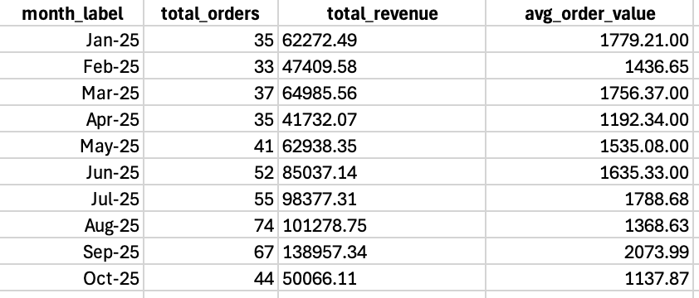
T1 - Monthly Performance

Slide 3
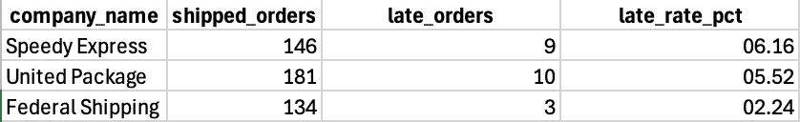
T2 - Shipper SLA (YTD)

Slide 4
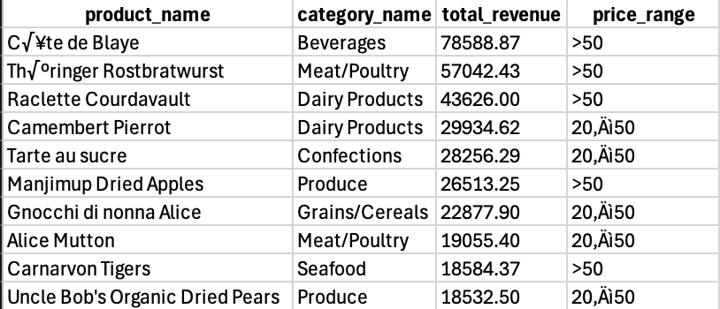
T3 — Top 10 Products by Revenue (YTD)

Slide 5
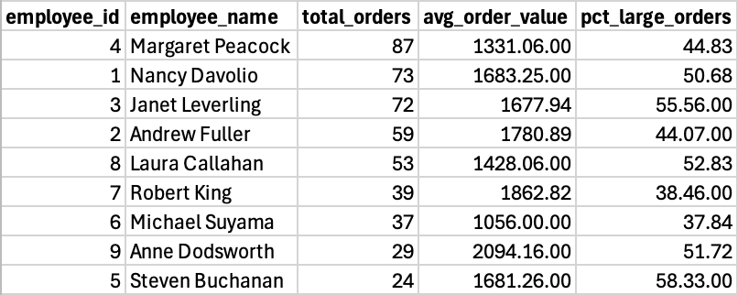
T4 — Sales Rep Scorecard (YTD)

Slide 6

T5 — New vs Loyal Customers (YTD)

